Slide 1

Machine Learning – Certification Program (Aug 2018)
Code Assignment – Module 6 (Classification)
Phone : +91 9999658436
Offices : Bengaluru, New Delhi
Email : contact@cellstrat.com
Web : www.cellstrat.com
CellStrat™ Confidential. All Rights Reserved.

Slide 2
Module 6
Classification

Slide 3

Questions
pima-logisticRegression.ipynb (Set 1 code)
Logistic Regression
1) Cell 4: Use feature no 1 and 3 for X
2) Cell 4: Use 20% of data for test set
3) What is purpose of “C” in this line :-
lr = LogisticRegression(C=100.0, random_state=1)
Try with C =10 and C=1000. What happens to result ?
4) Try using all 8 features in input X. What happens to result ? If we do not change the plotting code at the end, what kind of plot gets produced at the end with 8 input features?
Notes:
Merge Sort?

Slide 4
Questions
pima-knn.ipynb (Set 1 code)
KNN
Cell 5: Use 10 nearest neighbors to classify the data. Does it improve the accuracy? What happens to output plot ?
What is meant by metric='minkowski‘ ? With k=5, try changing to another metric and see how the output changes.
Notes:
Merge Sort?

Slide 5
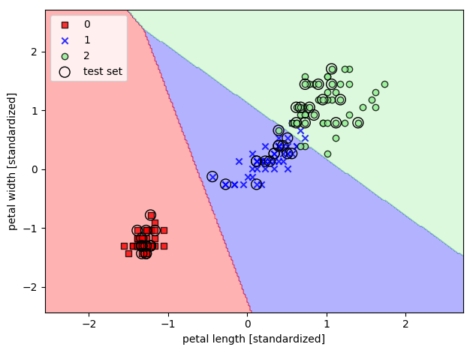
Questions
Classification - Logistic Regression Scikit Learn.ipynb (Set 2 code)
Name – Classify the IRIS flower dataset using Logistic Regression
Q1) What is Logistic Regression. Is it supervised or un-supervised learning ?

Slide 6
Questions
Classification - Logistic Regression Scikit Learn.ipynb (Set 2 code)
Name – Classify the IRIS flower dataset using Logistic Regression
Q2) What does this line of code print in Cell 7. What does it mean ?
print('Labels counts in y:', np.bincount(y))

Slide 7
Questions
Classification - Logistic Regression Scikit Learn.ipynb (Set 2 code)
Name – Classify the IRIS flower dataset using Logistic Regression
Q3) With respect to Cell 12, which uses the API lr.predict_proba, print the probabilities for first 10 rows. What is the sum of probabilities in each row ?

Slide 8
Questions
Classification - Logistic Regression Scikit Learn.ipynb (Set 2 code)
Name – Classify the IRIS flower dataset using Logistic Regression
Q4) What are we doing in Cell No 18 which has the line :-
for c in np.arange(-5, 5):

